Slide 1

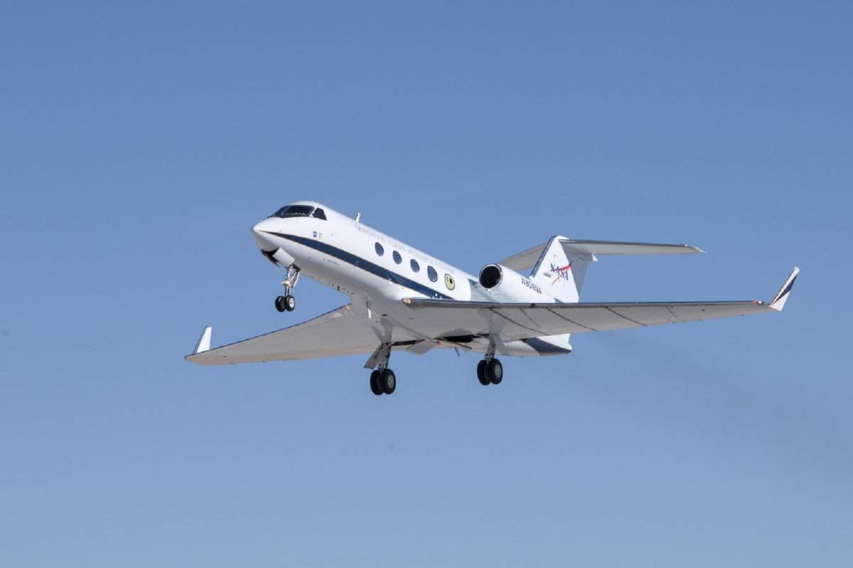
Aviation Company Risk Assessment .

Slide 2
OBJECTIVES
Investigate the relationship between engine type and the frequency of accidents.
Examine the correlation between the number of engines per aircraft and the recorded number of accidents.
Identify and analyze key factors that contribute to aircraft accidents, such as weather conditions and amateur-built aircraft.

Slide 3
Incident Overview and Key Statistics
Number of Incidents: 88,890
Number of Countries: 216
Weather Conditions: 3 Types
Engine Types: 10 Types
Incident Severity: Minor to Fatal

Slide 4
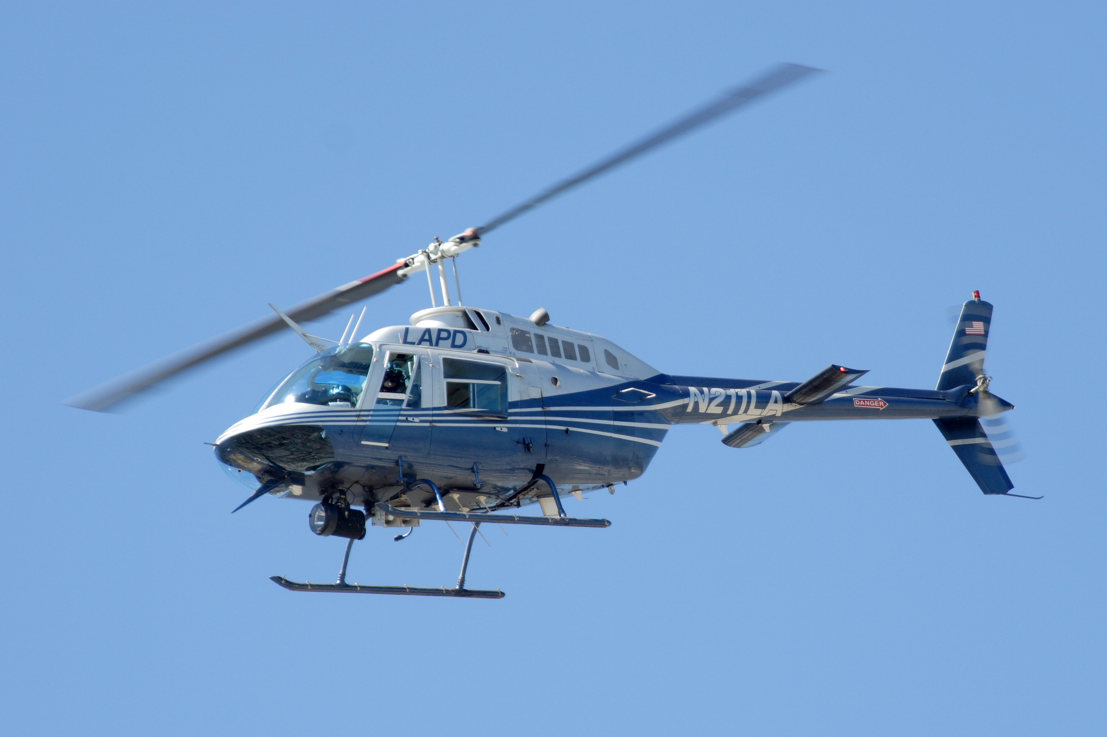
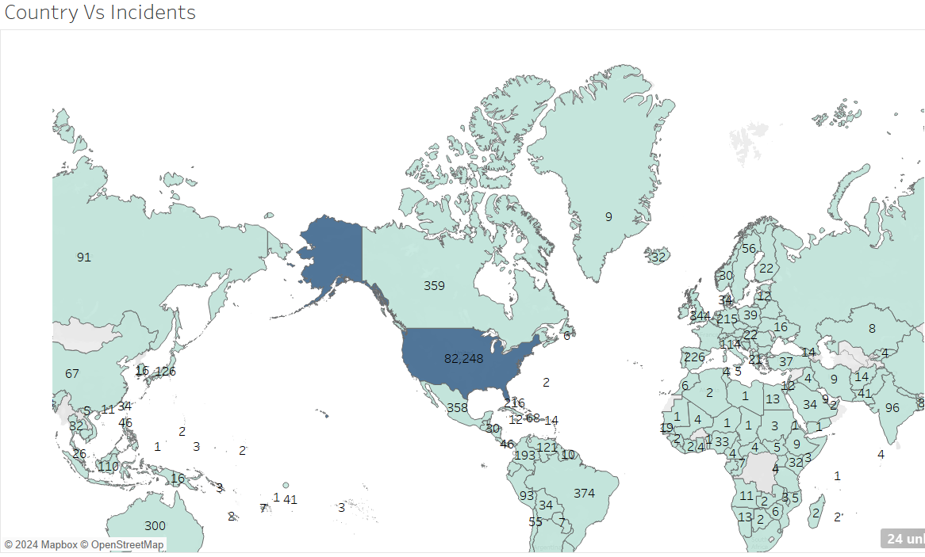
Incidents and Countries
United States accounts for 93 % of the recorded incidents.
This is due to its high volume of its air traffic and high standards of reporting
African countries has the least records with South Africa, Nigeria and Kenya taking the lead

Slide 5
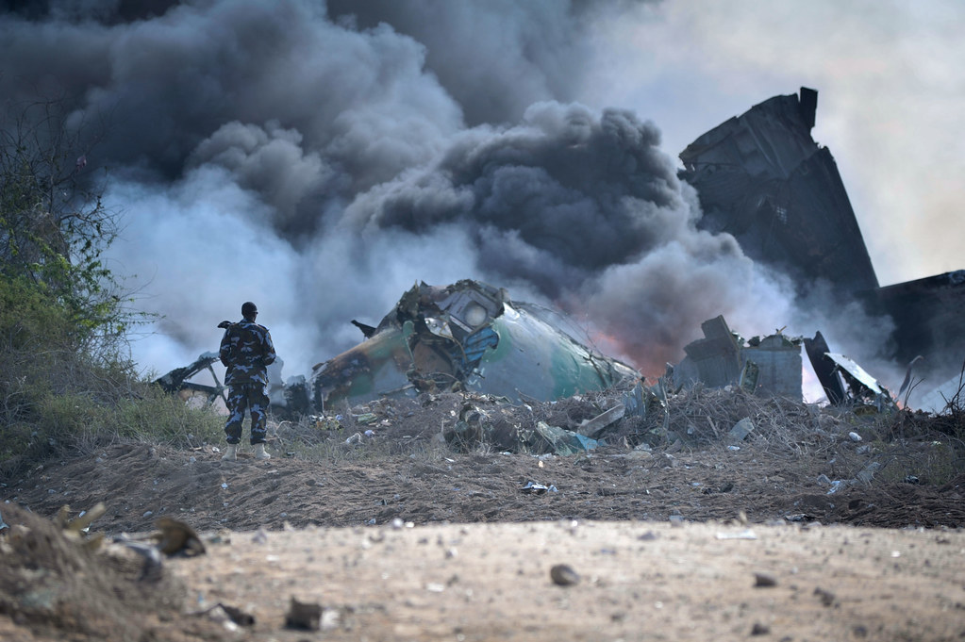
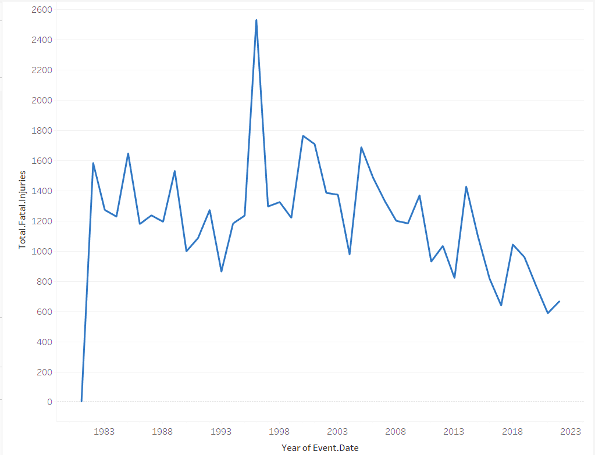
Accidents Trends
Aircraft accidents:
1996 Recorded the highest incidents
United states still registered the highest incidents

Slide 6

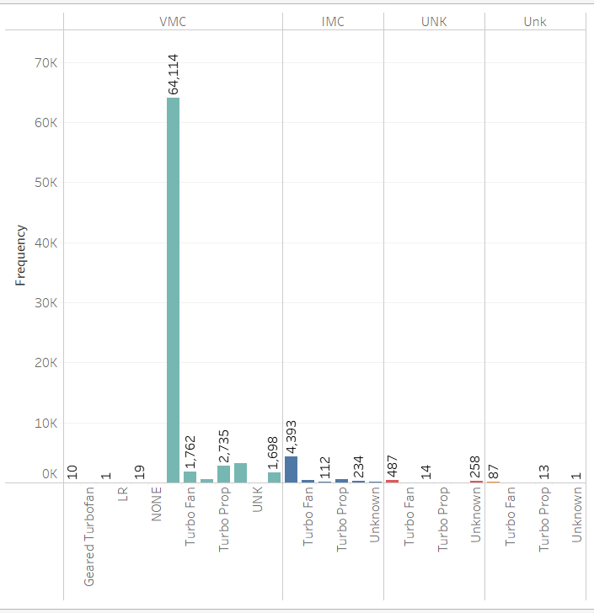
Weather Conditions
.
Weather is a significant contributor to the accident's occurrence irrespective of the type of aircraft
The best time to fly is under the Unk
Weather while the worst time is the VMC Weather Condition

Slide 7

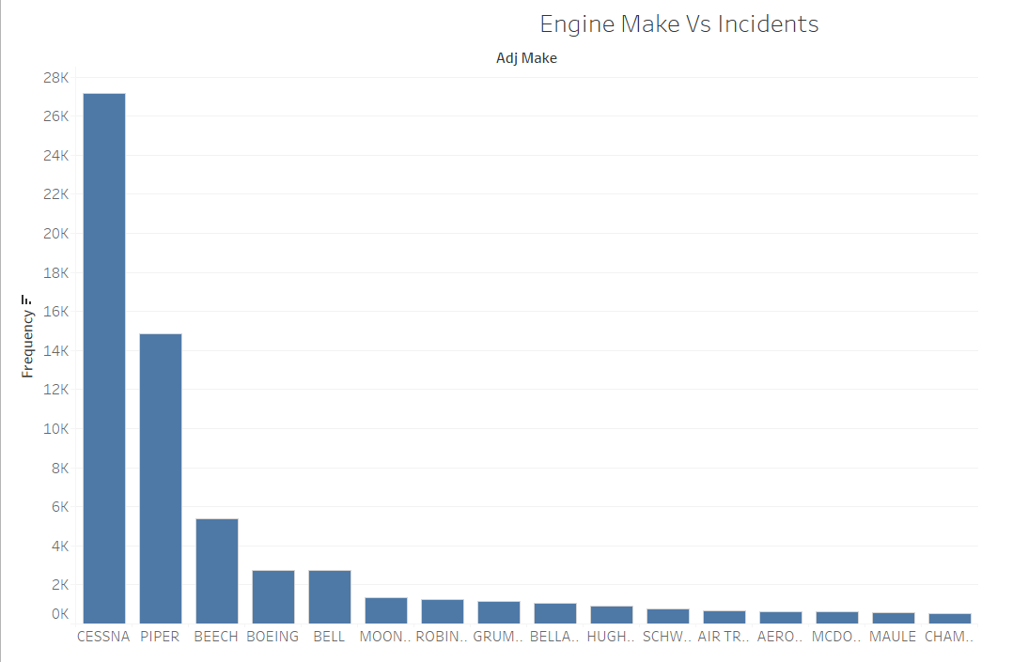
.
Most aircraft involved in incidents uses the Cessna Engines.
Cessna, Piper and Beech more likely to be involved in an accident under the VMC Weather condition

Slide 8
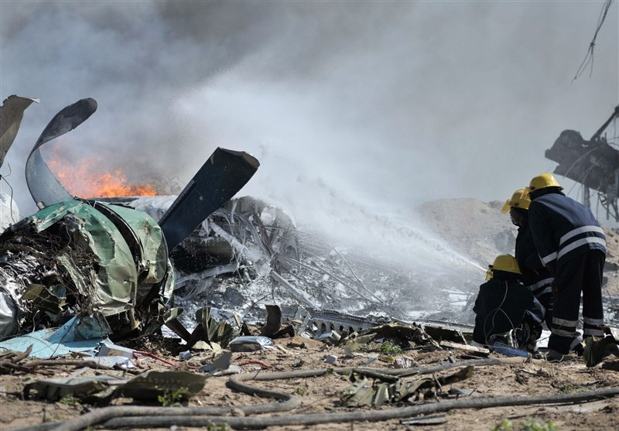
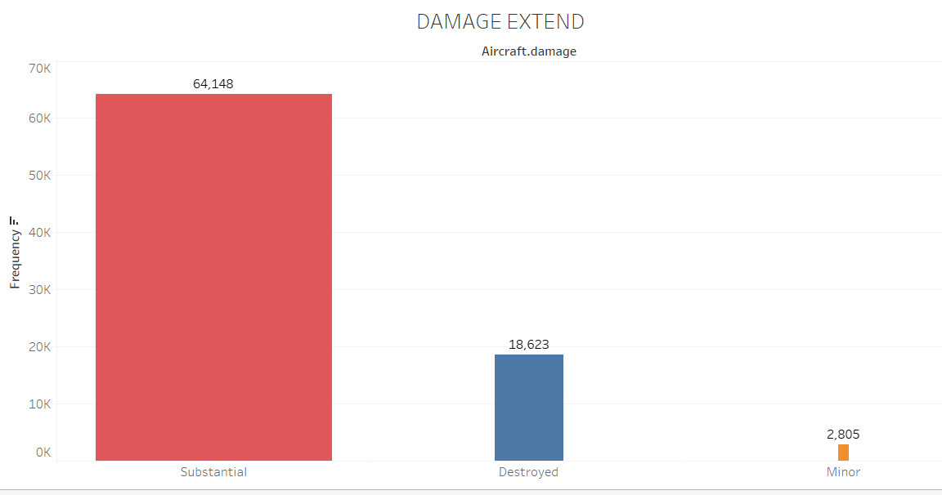
Damage Extend
97% of all the incidents recorded resulted in either the aircraft being completely or substantially destroyed

Slide 9
KEY FINDINGS SUMMARY
Accidents are more likely to happen in specific weather conditions compared to others .i.e VMC
The reciprocation engine type preforms poorly in the VMC weather condition
There is a 13% Chance of an occurrence of an aviation accident

Slide 10
RECOMENDATIONS
Reciprocating engines are is not reliable. Makes up 84% of all the recorded incidents
Address Weather-Related Risks: could be caused by :
a) Ineffective weather monitoring systems
b) Pilot trainings and prior experience piloting in adverse weather
Study and Trainings: Countries with many minor or non-fatal accidents to be used for targeted pilot training and enhanced preventive measures.

Slide 11
Thank You!
By Job Cheruyot
Email: jobcheruyot@gmail.com

